Slide 1
COMS10003 : Linear Algebra
Solving Linear Equations and Inverting Matrices
Gaussian Elimination and the Gauss-Jordan Method
Andrew Calway

Slide 2
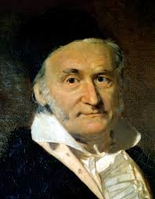
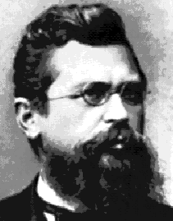
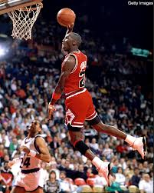
Gauss and Jordan
Johann Carl Friedrich Gauss
1777-1855
Wilhelm Jordan
1842-1899
Michael Jordan
1963-

Slide 3
Linear Systems - Equations
Find values of which satisfy all m equations

Slide 4
Linear System : Matrix-Vector Multiplication
Find the vector x which satisfies the above equation

Slide 5
One Solution
Consistent system

Slide 6
No Solution
Inconsistent system

Slide 7
Infinite Number of Solutions
Consistent system

Slide 8
Solutions for Linear Systems
A single unique solution; or
No solution; or
An infinite number of solutions

Slide 9
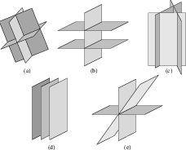
3x3 Linear Systems

Slide 10
3x3 Linear Systems - Solutions
No
solution
Unique
solution
No
solution
No
solution
Infinite
number of
solutions

Slide 11
Solving Linear Systems
Solving 2x2 systems is easy by substitution
Solving 3x3 systems is harder by substitution
Solving nxn systems – substitution not practical – need systematic, efficient solution
Gaussian Elimination

Slide 12
3 Elementary Operations
GE is based on following operations which gives
new system with same solution set:
Replacing one equation with sum of itself with another
Multiply all terms in one equation by by non-zero constant
Interchange any two equations

Slide 13
Gaussian Elimination - Example
pivot
pivot equation
(1)
(1)
(2)
(2) <-- (2) - (1)
(3)
(3) <-- (3) - (1)
Eliminate by scalar multiplying and subtracting pivot equation
(1)
back substitution
(2)
(3) <-- (3) – 2(2)
Triangular form
Multiplier=coefficient/pivot → 4/2

Slide 14
Gaussian Elimination
Reduce equations to triangular form using forward elimination
Forward elimination – remove left-most terms by scaling and subtracting pivot equation
multiplier = coefficient/pivot
Find solution using back substitution

Slide 15
Matrix Notation
Echelon
“step”
form

Slide 16
Equation Interchange
(1)
(1)
(2)
(2) <-- (2) - 3(1)
(3)
(3) <-- (3) - (1)
(1)
back substitution
(2) <-- (3)
(3) <-- (2)

Slide 17
Breakdown of Elimination
when pivot = zero and equation interchange doesn’t help
(1)
(1)
(2)
(2) <-- (2) - 3(1)
(3)
zero pivot
(3) <-- (3) - (1)
No solution
inconsistent
(1)
(1)
(2)
(2) <-- (2) - 3(1)
(3)
zero pivot
(3) <-- (3) - 2(1)
Infinite number solutions
consistent

Slide 18
Matrix Inverse
Standard
basis
Solve using GE, but altogether since all have same A

Slide 19
Gauss-Jordan Method
Apply GE to augmented matrix AI

Slide 20
G-J Method : Example
inverse
R1→R1/2
R2→ R2/8
R1→R1+ R2/8
R2→R2-2R1
R3→R3+ R1
R1→R1- R3
R3→R3+ R2
R2→R2+ 2R3

Slide 21
Gauss-Jordan Method : Solution

